Slide 1
Proposed Petroleum Regulations and Regulatory Impact Statement Q&A session
August 2021
Earth Resources Policy & Programs
Department of Jobs, Precincts & Regions

Slide 2
Agenda
Petroleum legislation and regulation in Victoria
Government’s decision to restart the onshore conventional gas industry
Findings of the Victorian Gas Program
The draft regulations
Regulatory Impact Statement
We are seeking your feedback
How to have your say

Slide 3
Petroleum legislation and regulation in Victoria
Primary legislation
Petroleum Act 1998
Guidelines
Code of Practice
Subordinate legislation
Petroleum Regulations 2021
Petroleum Amendment Act 2020

Slide 4
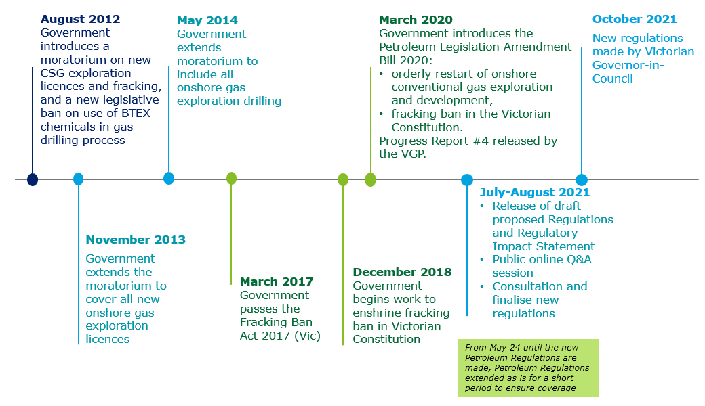
Government’s decision to restart the onshore conventional gas industry

Slide 5
Victorian Gas Program (2017-2020)
Three years of scientific studies by the Geological Survey of Victoria, the State’s geoscience agency included:
Geoscientific, technical and environmental studies
CSIRO social research and extensive community engagement
Assessment of risks, benefits & impacts of different development scenarios
Studies oversighted by:
Independent Stakeholder Advisory Panel, chaired by Victoria’ Lead Scientist and made up of representatives of farmers, regional councils, employers, environmentalists, community groups, industrial gas users, and unions.
5

Slide 6
Key findings of Victorian Gas Program (2017-2020)
Victoria likely to have between 128 – 830 PJ of potential new discoveries of conventional gas in parts of Gippsland and south-west Victoria
There would be no material impact to ground and surface water quality or quantity
Exploration and extraction activities would see a very small impact on the State’s greenhouse gas emissions equivalent of 0.1 to 0.3 per cent of Victoria’s 2017 emissions.
CSIRO survey showed 4 out of 5 people in south-west and Gippsland would tolerate, be okay, accept or embrace onshore conventional gas development
Development of onshore conventional gas could create up to 242 jobs and about $300m in gross regional product p.a.
The projected potential gas supply will increase energy security, but will not meet Victoria’s forecast shortfalls, nor reduce prices, nor change gas demand or consumption
Independent Stakeholder Advisory Panel advised that an onshore conventional gas industry would not compromise Victoria’s environment or agricultural sector
All reports published online
6

Slide 7
Key findings of Victorian Gas Program (2017-2020)
The Victorian petroleum regulatory framework was assessed as robust for managing operational, environmental and safety risks
Key regulatory gaps and inadequacies exist:
consideration and management of broader industry impacts on the economy, environment and communities in regulatory decision-making
community engagement obligations
transparency of regulatory decisions and industry activities
information asymmetries between industry and land holders

Slide 8
Draft regulations
Option 2 – Standards based
Regulations area | Stronger focus on:
Petroleum titles Application, Notice, Surrender, Decision-Making | community consultation consideration of economic, social and environmental factors
Operation plans Consultation Process (new) Environment Management Plan Well Operation Management Plan (WOMP) Rehabilitation Plan (new) Notification and review requirements | lifecycle stages and granularity risk identification and management community engagement throughout the operation groundwater and hydrocarbon emissions management operator competency notifying the regulator on progress, key events and risk changes
Reports to government Annual Reports Production Reports Incident Reports Operational Reports Geological Data Reports | ongoing operations well construction, decommissioning and rehabilitation changes in risks and liabilities incidents community engagement
Code of Practice Technical Standards, Specifications and Processes for WOMP Requirements of the Regulations | key well phases – construction, operation, suspension and decommissioning

Slide 9
Making Regulations and the role of a Regulatory Impact Statement
Preliminary consultation to inform development of proposed Regulations
Public consultation on the RIS and proposed Regulations
Consideration of all submissions on the RIS and proposed Regulations
Final decision on whether to make Regulations as proposed
Notice of decision and Statement of Reasons published
Development of a Regulatory Impact Statement (RIS) and draft Regulations
The RIS aims to identify the option that achieves the objectives and generates the highest net benefit to society
Regulatory Impact Statements:
consider the costs, benefits and alternatives to regulatory changes
present a best-practice, transparent framework for undertaking an assessment of the economic and social impacts of regulatory changes
provide a mechanism for government to engage with stakeholders likely to be affected by regulatory changes
ensure that there is an adequate level of public consultation in the development of subordinate legislation

Slide 10
We are seeking your feedback
How do the proposed regulations:
Encourage
investment in Victoria
Support
community engagement and consultation
Ensure
that social, economic and environmental factors are considered
Manage
risks and impacts
Provide
a clear administrative framework to facilitate petroleum development

Slide 11
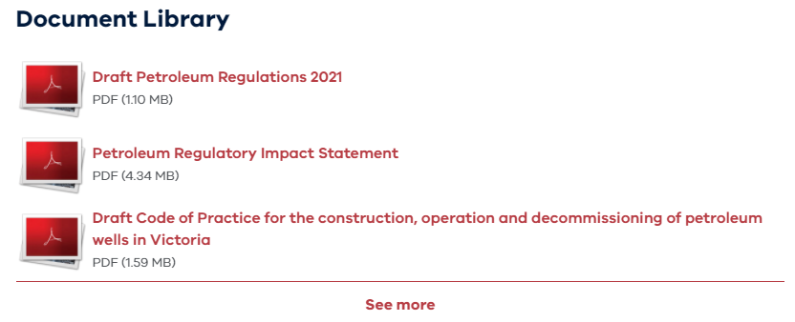
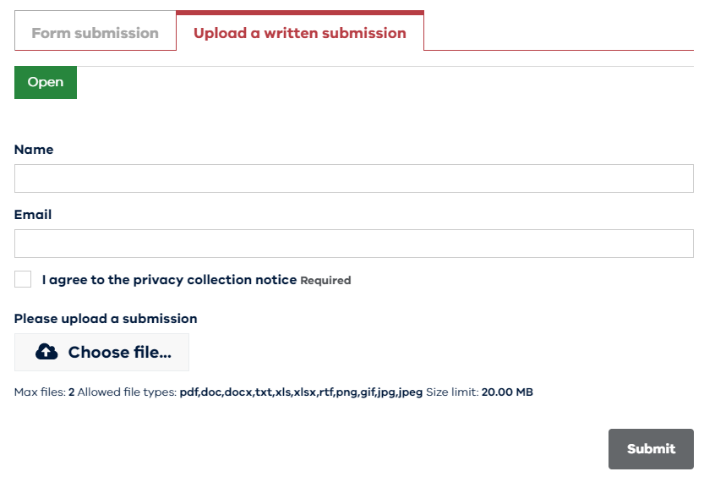
How to engage with the RIS via Engage Victoria
www.engage.vic.gov.au/regulatory-impact-statement-draft-petroleum-regulations

Slide 12
Further questions asked during the session
These questions were raised during the online information session but not answered on the day due to time constraints
Q: Can a gas company enter a compensation contract with Farmer A but then drill under Farmer B property without entering a contract with Farmer B?
A: Yes. Compensation agreements must be in place under s128 of the Petroleum Act 1998 between the company and the land-owner of private land on which the operation takes place. However, compensation under s129 of the Petroleum Act 1998 is payable to all owners and occupiers of private land if it is established that there is loss or damage to the land resulting from the petroleum operation.
Q: Is any aspect of the legislation retrospective?
A: No. There is nothing in the Petroleum Act 1998 that can make people or companies criminally responsible for something that was not against the law when they did it.

Slide 13
Further questions asked during the session
Q: Achieving the AEMO ISP ‘Staged Pathway’ option may not require new fossil gas thus eliminating the need for additional fossil gas development. Has this possibility and demand reduction due to the Victorian gas substitution plans been taken into account in the onshore drilling planning and approval process?
A: The Victorian Government is committed to meeting the requirements of the Climate Change Act 2017 to achieve net zero emissions by 2050. The Government is also committed to ensuring that the State has secure and reliable energy as it transitions to a cleaner energy future.
The amount of gas being processed in Victoria is declining and future demand is uncertain. New strict regulatory requirements are being put in place for the petroleum industry and new gas production will need to be prioritised for local use. All future gas projects will be developed within this context.
Q: Was there any consideration given to the impact of tariffs imposed by international customers of our agricultural exports?
A: The Victorian Gas Program found that the onshore conventional gas industry would not compromise the States agricultural credentials. This was concluded following a risks, benefits and impacts assessment undertaken against a range of farming and food industry measures. Impact of tariffs was not specifically identified as a measure by the program’s Stakeholder Advisory Panel.

Slide 14
Further questions asked during the session
Q: How will rehabilitation bond values be determined?
A: The definition of ‘rehabilitation bond’ in the Petroleum Act 1998 (section 172) specifies the rehabilitation bond money is for ‘any rehabilitation work, clean-up work or pollution prevention work that may be necessary as a result of a petroleum operation’.
The Minister assesses the amount, and sets rehabilitation bonds in relation to rehabilitation work, as defined in the Act. The definition constrains what may be assessed as a ‘rehabilitation liability’.
The Act also allows the Minister to increase the bond if the Minister believes the amount secured by a rehabilitation bond is insufficient (section 174).
Q: Based on the fracking Ban and these regulations, does that mean no stimulation of wells is allowed?
A: It is an offence under section 16A of the Petroleum Act 1998 to carry out hydraulic fracturing. Hydraulic fracturing is defined under the Act as the injection of a substance or substances into a bore under pressure for the purposes of stimulating a geological formation.

